Slide 1
GetGoing User Manual
SoftwareFun
CZ2006 Software Engineering
Sem 2 AY2018-2019

Slide 2
Page Contents
Title
Contents
Opening the App
The Form
Interacting with the Navigation Bar
Picking a Route
Accessing the Route
Push Notifications
History
Favourites

Slide 3
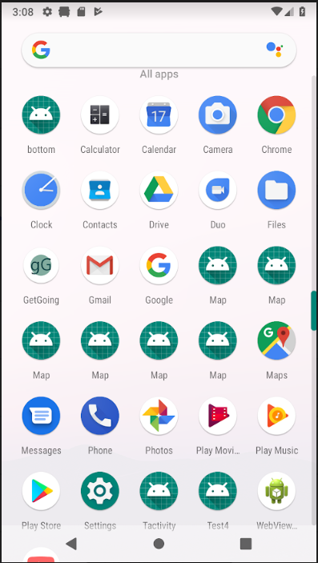
Opening the App
You can open the app by touching the icon for the app, which is gG.

Slide 4
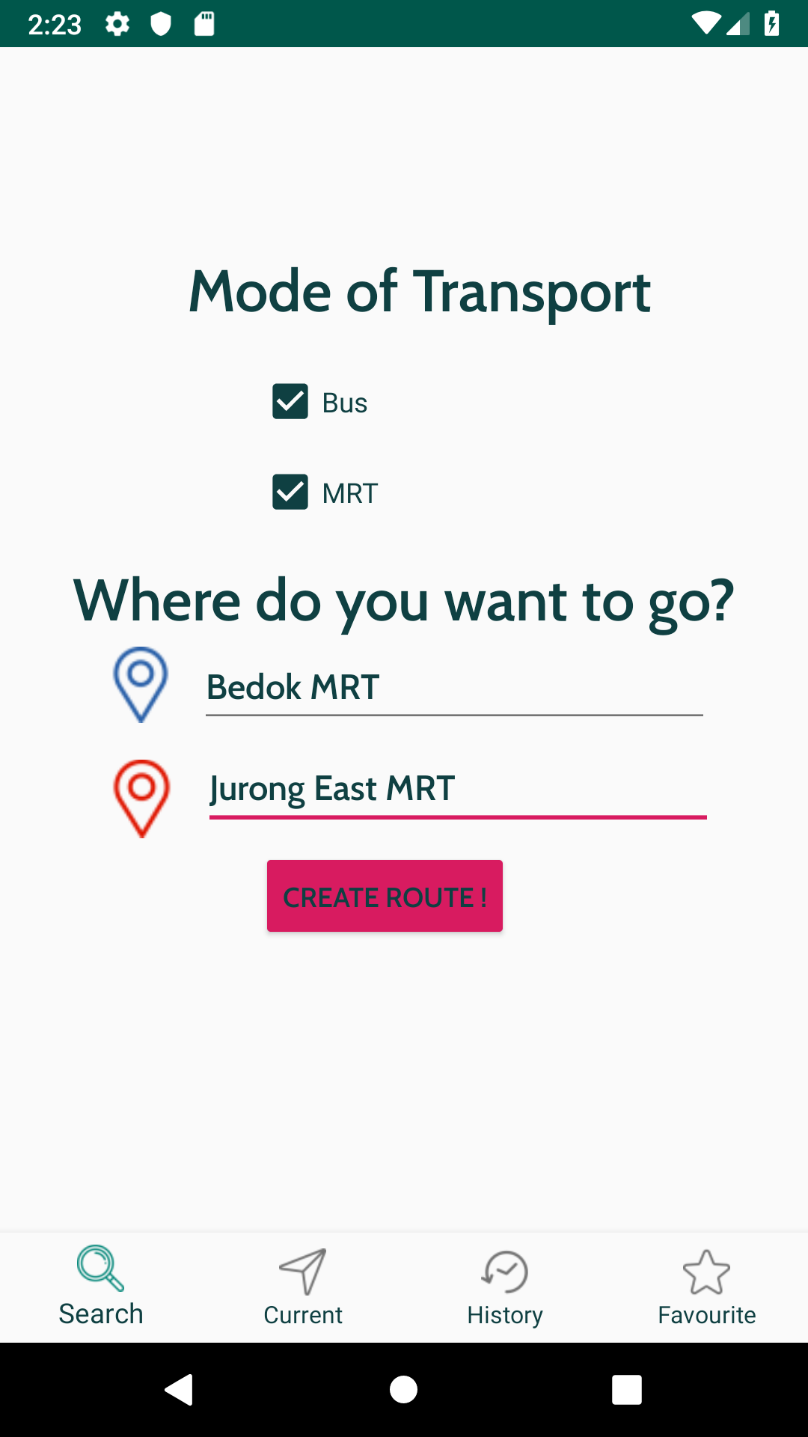
The Form
Touch the checkbox for Bus if you wish to include routes with the bus.
Touch the checkbox for MRT if you wish to include routes with the MRT
Touch the input box near the blue location icon and type in your origin.
Touch the input box near the red location icon and type in your destination.
Touch Create Route to see the list of routes available.

Slide 5
Interacting with the Navigation Bar
Touch the Search icon to get to the Form page.
Touch the Current route page to open the page displaying the route you are currently on.
Touch the History page to see the list of routes you have taken.
Touch the Favourites page to see the list of routes you have favourited.

Slide 6
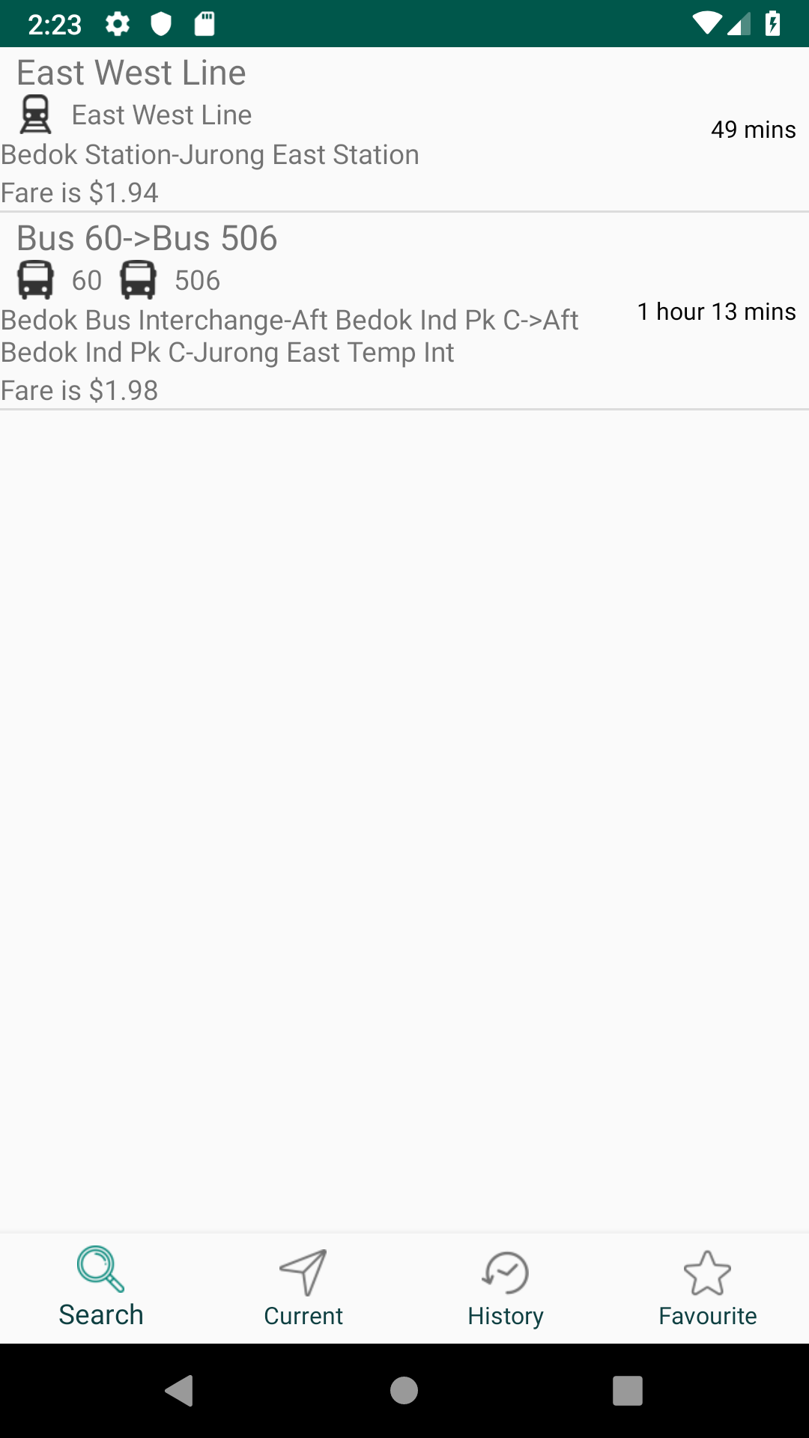
Picking a Route
You can see a list of routes that are according to your preferences.
The name of the interchanges is displayed.
The total fare of the route is displayed.
The total time of travel is displayed.
Touch any of the routes to load it as a current route.

Slide 7
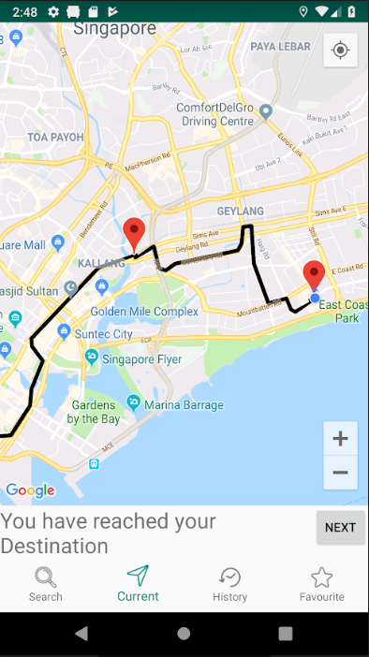
Accessing the Route
A Google map is displayed showing the current leg of the route.
Red location markers display where interchanges have to be made in the mode of transit.
You can click next to advance to the next leg of your journey.
A blue dot shows where you are currently.
Normal map functionalities like zooming by pinching can be performed too.

Slide 8
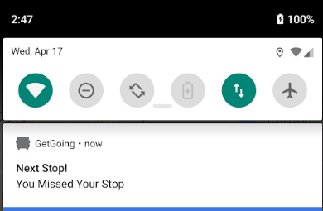
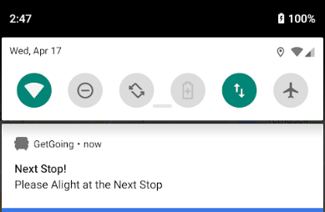
Alert Alight
A notification is generated when it is time for you to get off the bus or MRT at the upcoming stop.
A notification is created when you have missed your stop that you were supposed to get off on.

Slide 9
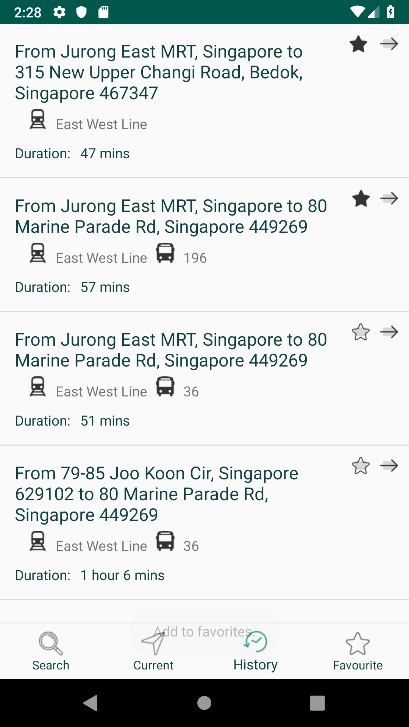
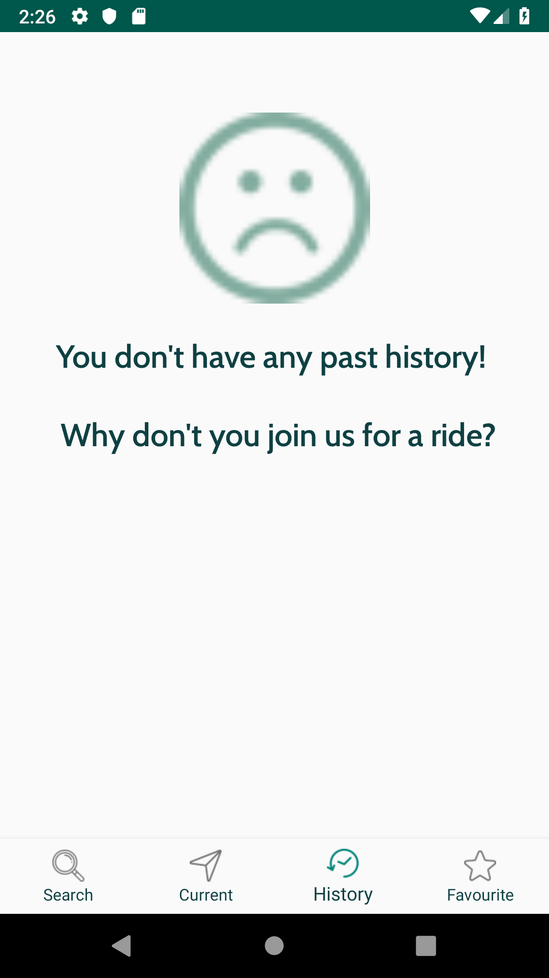
History
List of routes that have previously been taken is displayed.
If no route has been taken before, empty page is displayed saying no past history.
Touch any route to load it into the current route page.
A dark star indicates the route is a favourite.
Touch a star to toggle between favourite or not.

Slide 10
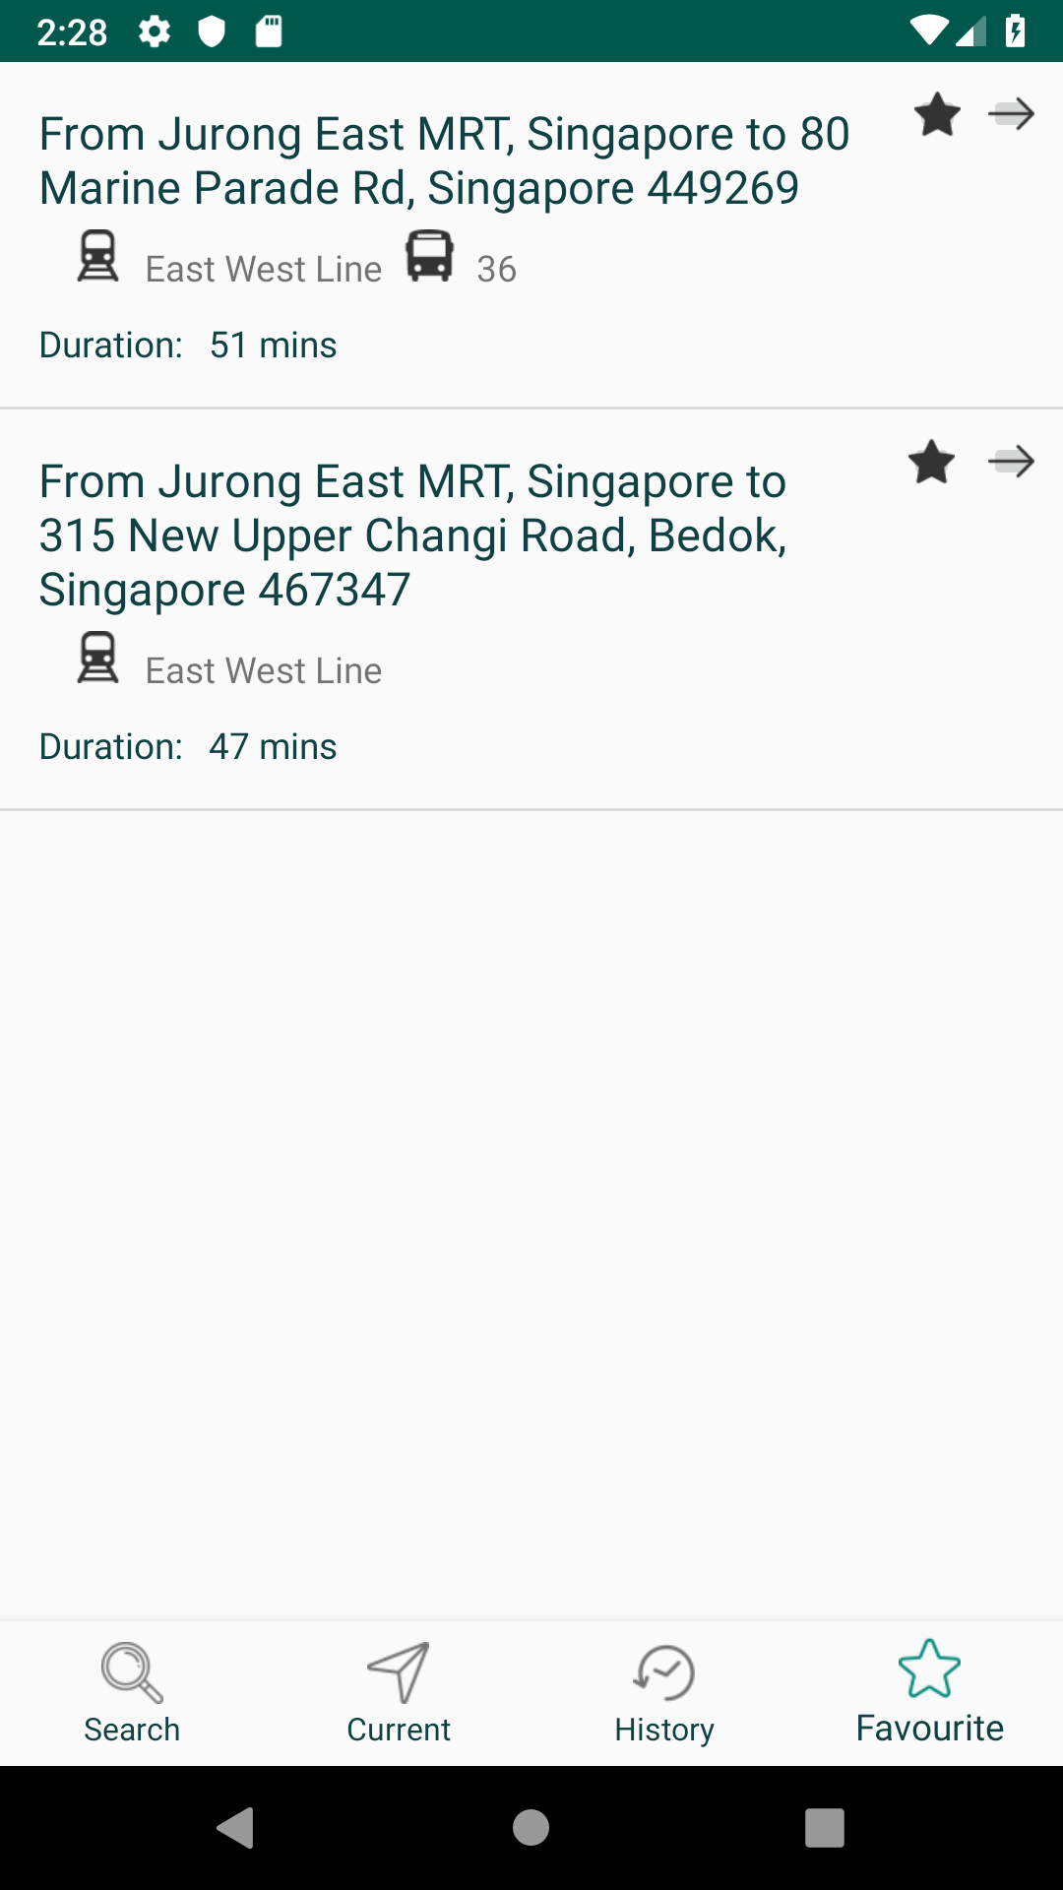
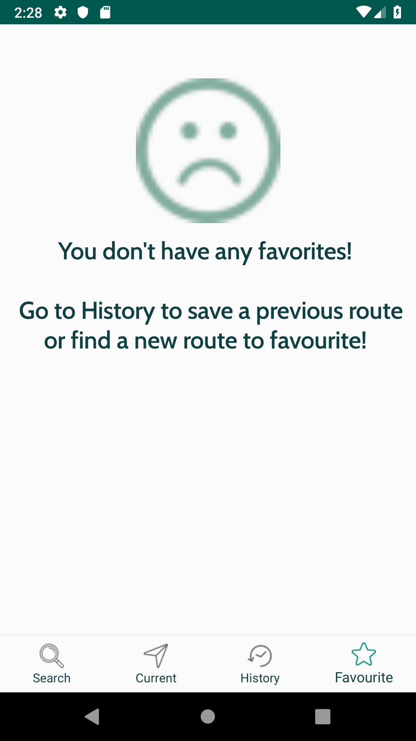
Favourites
List of routes that have been favourites is displayed.
If no route has been favourited before, empty page is displayed saying no past history.
Touch any route to load it into the current route page.
A dark star indicates the route is a favourite.
Touch a star to toggle between favourite or not.

